Slide 1
Wasserstein Weisfeiler-Lehman Graph Kernels Matteo Togninalli, Felipe Llinares-López, Elisabetta Ghisu, Bastian Rieck, Karsten Borgwardt – ETH ZURICH
Fabrice Beaumont Rheinische Friedrich-Wilhelms-Universität Bonn
01.07.2020

Slide 2
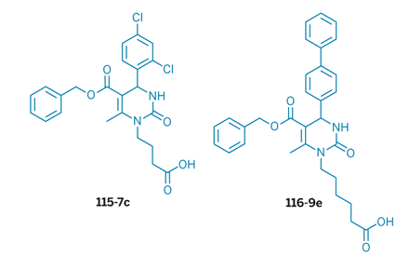
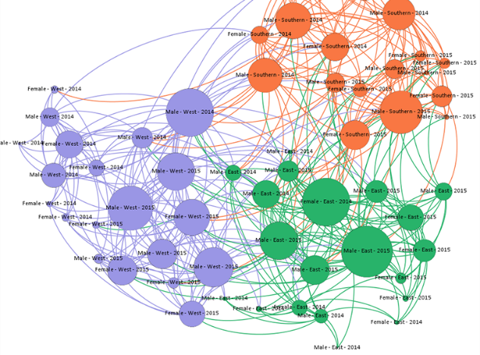
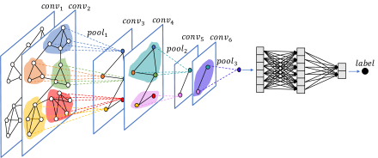
Motivation
TASK: Graph classification (via graph kernels as similarity measure)
Bioinformatics
Social Network analysis
Computer vision
5 / 6
Notes:
TODO: example for uses of graph classifications
TODO: examples of naive aggregation

Slide 3
Motivation
TASK: Graph classification (via graph kernels as similarity measure)
Solution: R-Convolution kernels
Problem: 1. Naive aggregation of substructures may disregard valuable information
2. Only a few approaches extendible for continuously labelled graphs
5 / 6
Notes:
TODO: example for uses of graph classifications
TODO: examples of naive aggregation

Slide 4
Method Overview
Transform each graph into a set of node embeddings
Weisfeiler-Lehman node embedding scheme
WL-features
Measure the Wasserstein distance between each pair of graphs
Ground distance (similarity matrix)
Wasserstein distance
Wasserstein Weisfeiler-Lehman kernel definition
(Differentiate between a finite set of categorical node labels and real valued node attributes)
Optimal transport
1 / 6

Slide 5
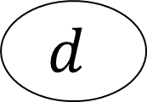
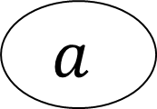
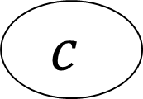


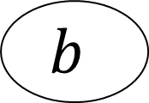
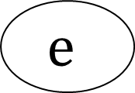
1.1 Weisfeiler-Lehman node embedding scheme Idea
$$a$$
$$b$$
$$a$$
$$c$$
$$c$$
$$d$$
$$e$$
1 / 6

Slide 6
1.1 Weisfeiler-Lehman node embedding scheme Idea
$$a$$
$$b$$
$$a$$
$$c$$
$$c$$
$$d$$
$$e$$
1 / 6

Slide 7
1.1 Weisfeiler-Lehman node embedding scheme Idea
$$a$$
$$b$$
$$a$$
$$c$$
$$c$$
$$d$$
$$e$$
1 / 6

Slide 8
1.1 Weisfeiler-Lehman node embedding scheme Idea
$$a$$
$$b$$
$$a$$
$$c$$
$$c$$
$$d$$
$$e$$
1 / 6

Slide 9
1.1 Weisfeiler-Lehman node embedding scheme Idea
$$a$$
$$b$$
$$a$$
$$c$$
$$c$$
$$d$$
$$e$$
1 / 6

Slide 10
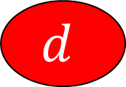
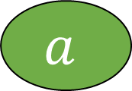



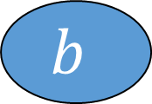
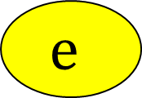
1.1 Weisfeiler-Lehman node embedding scheme Idea
$$a$$
$$b$$
$$a$$
$$c$$
$$c$$
$$d$$
$$e$$
1 / 6

Slide 11
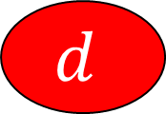



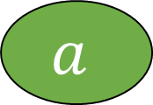
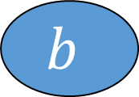
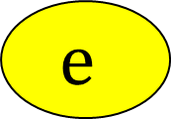
1.1 Weisfeiler-Lehman node embedding scheme Idea
$$a$$
$$b$$
$$a$$
?
?
?
$$c$$
$$c$$
?
?
$$d$$
$$e$$
?
?
1 / 6

Slide 12
1.1 Weisfeiler-Lehman node embedding scheme Idea
$$a$$
$$b$$
$$a$$
?
?
?
$$c$$
$$c$$
?
?
$$d$$
$$e$$
?
?
1 / 6

Slide 13
1.1 Weisfeiler-Lehman node embedding scheme Idea
$$a$$
$$b$$
$$a$$
x
?
?
$$c$$
$$c$$
?
?
$$d$$
$$e$$
?
?
1 / 6

Slide 14


1.1 Weisfeiler-Lehman node embedding scheme Idea
$$a$$
$$b$$
$$a$$
x
?
?
$$c$$
$$c$$
?
?
$$d$$
$$e$$
?
?
1 / 6

Slide 15
1.1 Weisfeiler-Lehman node embedding scheme Idea
$$a$$
$$b$$
$$a$$
x
q
?
$$c$$
$$c$$
?
?
$$d$$
$$e$$
?
?
1 / 6

Slide 16

1.1 Weisfeiler-Lehman node embedding scheme Idea
$$a$$
$$b$$
$$a$$
x
q
x
$$c$$
$$c$$
?
?
$$d$$
$$e$$
?
?
1 / 6

Slide 17

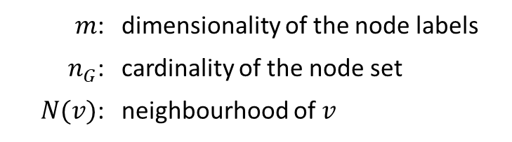
1.1 Weisfeiler-Lehman node embedding scheme Theory
$m$: | dimensionality of the node labels
$n_{G}$: | cardinality of the node set
$N(v)$: | neighbourhood of $v$
DISCRETE node labels | CONTINUOUS node labels
$$x^{h+1}\left(v\right)=hash(x^{h}\left(v\right), N^{h}(v))$$
Notes:
TODO: quick introduction for graphs and how they are used in the paper
WL-feature = node features of graph G at iteration h
Note: The compressed neighborhood labels are a set – not a multiset
Note: The function f^H concatenates the WL-features
„A graph embedding scheme is a function that outpusts a fixed-size vectorial representation for each node in the graph“

Slide 18

1.1 Weisfeiler-Lehman node embedding scheme Theory
$m$: | dimensionality of the node labels
$n_{G}$: | cardinality of the node set
$N(v)$: | neighbourhood of $v$
$$N^{h}(v)=\left\{x^{h}\left(u_{1}\right), …,x^{h}\left(u_{|N(v)|}\right)\right\}$$
DISCRETE node labels | CONTINUOUS node labels
$$x^{h+1}\left(v\right)=hash(x^{h}\left(v\right), N^{h}(v))$$
Notes:
TODO: quick introduction for graphs and how they are used in the paper
WL-feature = node features of graph G at iteration h
Note: The compressed neighborhood labels are a set – not a multiset
Note: The function f^H concatenates the WL-features
„A graph embedding scheme is a function that outpusts a fixed-size vectorial representation for each node in the graph“

Slide 19
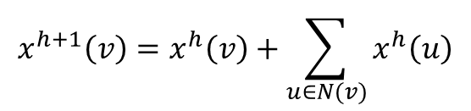
1.1 Weisfeiler-Lehman node embedding scheme Theory
$m$: | dimensionality of the node labels
$n_{G}$: | cardinality of the node set
$N(v)$: | neighbourhood of $v$
$$N^{h}(v)=\left\{x^{h}\left(u_{1}\right), …,x^{h}\left(u_{|N(v)|}\right)\right\}$$
DISCRETE node labels | CONTINUOUS node labels
$$x^{h+1}\left(v\right)=x^{h}\left(v\right)+\sum_{u∈N(v)}{x^{h}\left(u\right)}$$
$$x^{h+1}\left(v\right)=hash(x^{h}\left(v\right), N^{h}(v))$$
Notes:
TODO: quick introduction for graphs and how they are used in the paper
WL-feature = node features of graph G at iteration h
Note: The compressed neighborhood labels are a set – not a multiset
Note: The function f^H concatenates the WL-features
„A graph embedding scheme is a function that outpusts a fixed-size vectorial representation for each node in the graph“

Slide 20
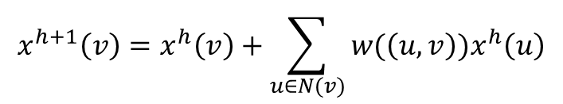
1.1 Weisfeiler-Lehman node embedding scheme Theory
$m$: | dimensionality of the node labels
$n_{G}$: | cardinality of the node set
$N(v)$: | neighbourhood of $v$
$$N^{h}(v)=\left\{x^{h}\left(u_{1}\right), …,x^{h}\left(u_{|N(v)|}\right)\right\}$$
DISCRETE node labels | CONTINUOUS node labels
$$x^{h+1}\left(v\right)=x^{h}\left(v\right)+\sum_{u∈N(v)}{w(\left(u,v\right))x^{h}\left(u\right)}$$
$$x^{h+1}\left(v\right)=hash(x^{h}\left(v\right), N^{h}(v))$$
Notes:
TODO: quick introduction for graphs and how they are used in the paper
WL-feature = node features of graph G at iteration h
Note: The compressed neighborhood labels are a set – not a multiset
Note: The function f^H concatenates the WL-features
„A graph embedding scheme is a function that outpusts a fixed-size vectorial representation for each node in the graph“

Slide 21
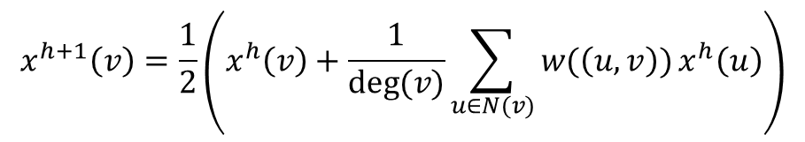
1.1 Weisfeiler-Lehman node embedding scheme Theory
$m$: | dimensionality of the node labels
$n_{G}$: | cardinality of the node set
$N(v)$: | neighbourhood of $v$
$$N^{h}(v)=\left\{x^{h}\left(u_{1}\right), …,x^{h}\left(u_{|N(v)|}\right)\right\}$$
DISCRETE node labels | CONTINUOUS node labels
$$x^{h+1}\left(v\right)=\frac{1}{2}\left(x^{h}\left(v\right)+\frac{1}{deg⁡(v)}\sum_{u∈N(v)}{w(\left(u,v\right))}x^{h}\left(u\right)\right)$$
$$x^{h+1}\left(v\right)=hash(x^{h}\left(v\right), N^{h}(v))$$
Notes:
TODO: quick introduction for graphs and how they are used in the paper
WL-feature = node features of graph G at iteration h
Note: The compressed neighborhood labels are a set – not a multiset
Note: The function f^H concatenates the WL-features
„A graph embedding scheme is a function that outpusts a fixed-size vectorial representation for each node in the graph“

Slide 22






1.1 Weisfeiler-Lehman node embedding scheme Theory
$m$: | dimensionality of the node labels
$n_{G}$: | cardinality of the node set
$N(v)$: | neighbourhood of $v$
$$N^{h}(v)=\left\{x^{h}\left(u_{1}\right), …,x^{h}\left(u_{|N(v)|}\right)\right\}$$
DISCRETE node labels | CONTINUOUS node labels
$$x^{h+1}\left(v\right)=\frac{1}{2}\left(x^{h}\left(v\right)+\frac{1}{deg⁡(v)}\sum_{u∈N(v)}{w(\left(u,v\right))}x^{h}\left(u\right)\right)$$
$$x^{h+1}\left(v\right)=hash(x^{h}\left(v\right), N^{h}(v))$$
$$∈ℝ^{m}$$
Node embedding
$$X_{G}^{H}(v_{1})=\left[x^{0}\left(v_{1}\right),…,x^{H}(v_{1})\right]$$
$$∈ℝ^{m(H+1)}$$
Graph embedding
$$f_{WL}^{H}:G⟶{\left(X_{G}^{H}\left(v_{1}\right), …,X_{G}^{H}(v_{n_{G}})\right)}^{T}$$
$$∈ℝ^{n_{G}×m(H+1)}$$
5 / 6
Notes:
TODO: quick introduction for graphs and how they are used in the paper
WL-feature = node features of graph G at iteration h
Note: The compressed neighborhood labels are a set – not a multiset
Note: The function f^H concatenates the WL-features
„A graph embedding scheme is a function that outpusts a fixed-size vectorial representation for each node in the graph“

Slide 23

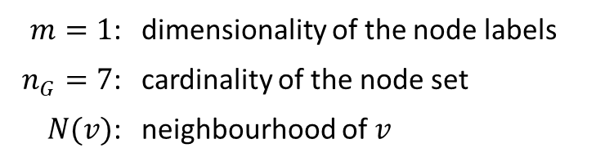
1.1 Weisfeiler-Lehman node embedding scheme Example – Node labels
$m=1$: | dimensionality of the node labels
$n_{G}=7$: | cardinality of the node set
$N(v)$: | neighbourhood of $v$
$$x^{h+1}\left(v\right)=hash(x^{h}\left(v\right), N^{h}(v))$$
5 / 6

Slide 24
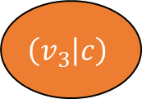
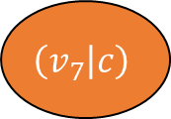
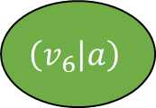
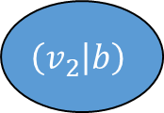
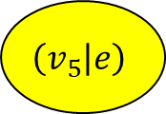
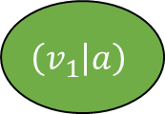
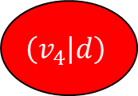
1.1 Weisfeiler-Lehman node embedding scheme Example – Node labels
$m=1$: | dimensionality of the node labels
$n_{G}=7$: | cardinality of the node set
$N(v)$: | neighbourhood of $v$
$$x^{h+1}\left(v\right)=hash(x^{h}\left(v\right), N^{h}(v))$$
$$\left(v_{1} | a\right)$$
$$\left(v_{2} | b\right)$$
$$\left(v_{6} | a\right)$$
$$\left(v_{3} | c\right)$$
$$\left(v_{7} | c\right)$$
$$\left(v_{4} | d\right)$$
$$\left(v_{5} | e\right)$$
5 / 6

Slide 25

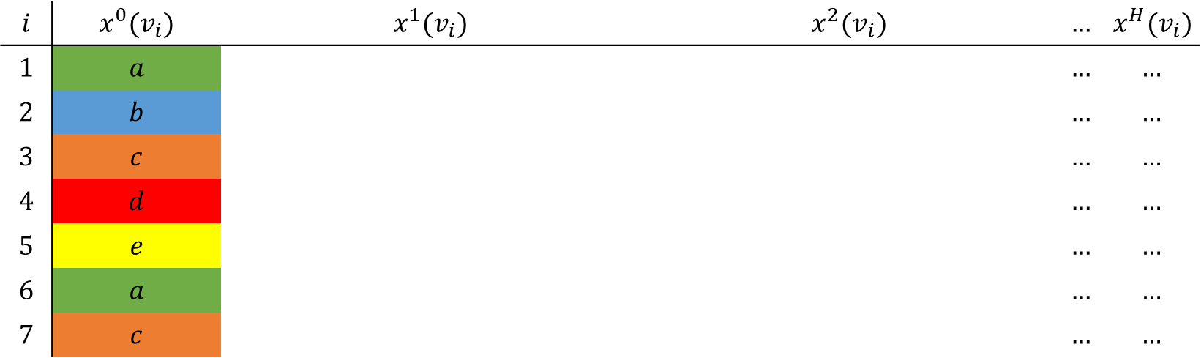






1.1 Weisfeiler-Lehman node embedding scheme Example – Node labels
$m=1$: | dimensionality of the node labels
$n_{G}=7$: | cardinality of the node set
$N(v)$: | neighbourhood of $v$
$$\left(v_{1} | a\right)$$
$$\left(v_{2} | b\right)$$
$$\left(v_{6} | a\right)$$
$$\left(v_{3} | c\right)$$
$$\left(v_{7} | c\right)$$
$$x^{h+1}\left(v\right)=hash(x^{h}\left(v\right), N^{h}(v))$$
$$\left(v_{4} | d\right)$$
$$\left(v_{5} | e\right)$$
$$i$$ | $$x^{0}(v_{i})$$ | $$x^{1}(v_{i})$$ | $$x^{2}(v_{i})$$ | $$…$$ | $$x^{H}(v_{i})$$
$$1$$ | $$a$$ |  |  | $$…$$ | $$…$$
$$2$$ | $$b$$ |  |  | $$…$$ | $$…$$
$$3$$ | $$c$$ |  |  | $$…$$ | $$…$$
$$4$$ | $$d$$ |  |  | $$…$$ | $$…$$
$$5$$ | $$e$$ |  |  | $$…$$ | $$…$$
$$6$$ | $$a$$ |  |  | $$…$$ | $$…$$
$$7$$ | $$c$$ |  |  | $$…$$ | $$…$$
5 / 6
Notes:
PAUL
1) Was war die Aufgabe? (Aufzählen von Bäumen; Korrektes Entscheiden von Teilgraph Isomorphie)

Slide 26
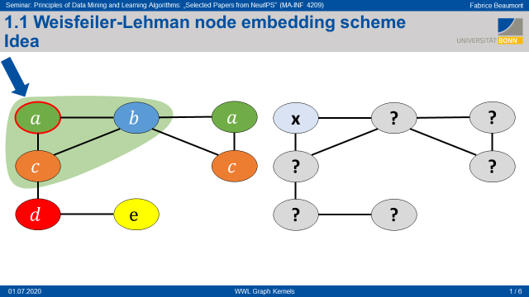
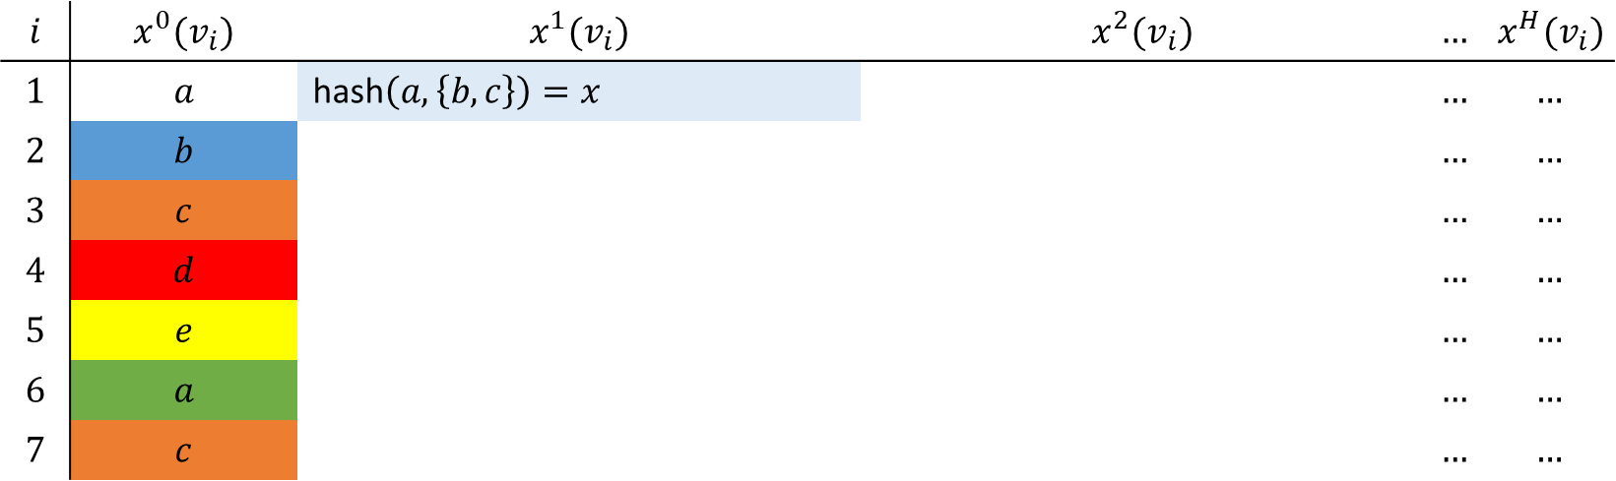
1.1 Weisfeiler-Lehman node embedding scheme Example – Node labels
$m=1$: | dimensionality of the node labels
$n_{G}=7$: | cardinality of the node set
$N(v)$: | neighbourhood of $v$
$$x^{h+1}\left(v\right)=hash(x^{h}\left(v\right), N^{h}(v))$$
$$i$$ | $$x^{0}(v_{i})$$ | $$x^{1}(v_{i})$$ | $$x^{2}(v_{i})$$ | $$…$$ | $$x^{H}(v_{i})$$
$$1$$ | $$a$$ | hash$\left(a,\left\{b, c\right\}\right)=x$ |  | $$…$$ | $$…$$
$$2$$ | $$b$$ |  |  | $$…$$ | $$…$$
$$3$$ | $$c$$ |  |  | $$…$$ | $$…$$
$$4$$ | $$d$$ |  |  | $$…$$ | $$…$$
$$5$$ | $$e$$ |  |  | $$…$$ | $$…$$
$$6$$ | $$a$$ |  |  | $$…$$ | $$…$$
$$7$$ | $$c$$ |  |  | $$…$$ | $$…$$
5 / 6
Notes:
PAUL
1) Was war die Aufgabe? (Aufzählen von Bäumen; Korrektes Entscheiden von Teilgraph Isomorphie)

Slide 27
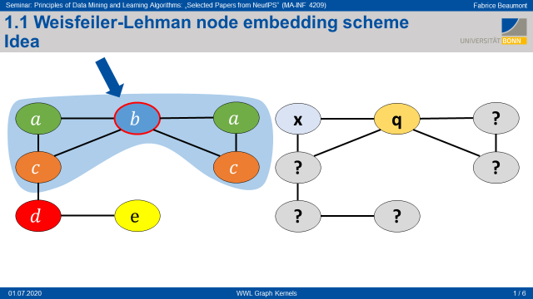
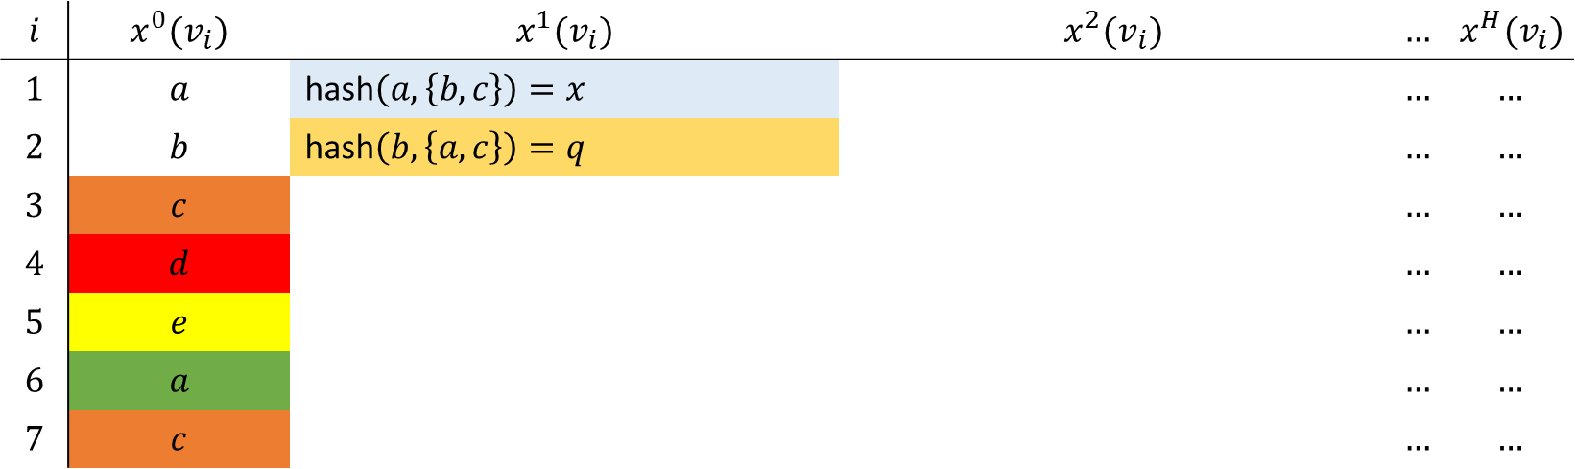
1.1 Weisfeiler-Lehman node embedding scheme Example – Node labels
$m=1$: | dimensionality of the node labels
$n_{G}=7$: | cardinality of the node set
$N(v)$: | neighbourhood of $v$
$$x^{h+1}\left(v\right)=hash(x^{h}\left(v\right), N^{h}(v))$$
$$i$$ | $$x^{0}(v_{i})$$ | $$x^{1}(v_{i})$$ | $$x^{2}(v_{i})$$ | $$…$$ | $$x^{H}(v_{i})$$
$$1$$ | $$a$$ | hash$\left(a,\left\{b, c\right\}\right)=x$ |  | $$…$$ | $$…$$
$$2$$ | $$b$$ | hash$\left(b,\left\{a, c\right\}\right)=q$ |  | $$…$$ | $$…$$
$$3$$ | $$c$$ |  |  | $$…$$ | $$…$$
$$4$$ | $$d$$ |  |  | $$…$$ | $$…$$
$$5$$ | $$e$$ |  |  | $$…$$ | $$…$$
$$6$$ | $$a$$ |  |  | $$…$$ | $$…$$
$$7$$ | $$c$$ |  |  | $$…$$ | $$…$$
5 / 6
Notes:
PAUL
1) Was war die Aufgabe? (Aufzählen von Bäumen; Korrektes Entscheiden von Teilgraph Isomorphie)

Slide 28











1.1 Weisfeiler-Lehman node embedding scheme Idea
$$a$$
$$b$$
$$a$$
$$c$$
$$c$$
x
q
x
$$d$$
$$e$$
$$Step 0$$
p
r
h
j
$$Step 1$$
k
o
g
r
s
w
f
$$…$$
$$Step 2$$
1 / 6

Slide 29

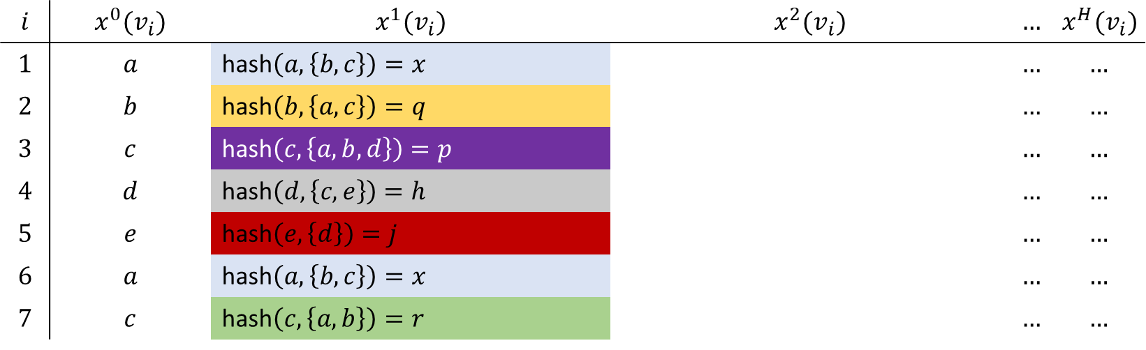






1.1 Weisfeiler-Lehman node embedding scheme Example – Node labels
$m=1$: | dimensionality of the node labels
$n_{G}=7$: | cardinality of the node set
$N(v)$: | neighbourhood of $v$
$$\left(v_{1} | x\right)$$
$$\left(v_{2} | q\right)$$
$$\left(v_{6} | x\right)$$
$$\left(v_{3} | p\right)$$
$$\left(v_{7} | r\right)$$
$$x^{h+1}\left(v\right)=hash(x^{h}\left(v\right), N^{h}(v))$$
$$\left(v_{4} | h\right)$$
$$\left(v_{5} | j\right)$$
$$i$$ | $$x^{0}(v_{i})$$ | $$x^{1}(v_{i})$$ | $$x^{2}(v_{i})$$ | $$…$$ | $$x^{H}(v_{i})$$
$$1$$ | $$a$$ | hash$\left(a,\left\{b, c\right\}\right)=x$ |  | $$…$$ | $$…$$
$$2$$ | $$b$$ | hash$\left(b,\left\{a, c\right\}\right)=q$ |  | $$…$$ | $$…$$
$$3$$ | $$c$$ | hash$\left(c,\left\{a, b,d\right\}\right)=p$ |  | $$…$$ | $$…$$
$$4$$ | $$d$$ | hash$\left(d,\left\{c, e\right\}\right)=h$ |  | $$…$$ | $$…$$
$$5$$ | $$e$$ | hash$\left(e,\left\{d\right\}\right)=j$ |  | $$…$$ | $$…$$
$$6$$ | $$a$$ | hash$\left(a,\left\{b, c\right\}\right)=x$ |  | $$…$$ | $$…$$
$$7$$ | $$c$$ | hash$\left(c,\left\{a, b\right\}\right)=r$ |  | $$…$$ | $$…$$
5 / 6
Notes:
Note: The compressed neighborhood labels are a set – not a multiset

Slide 30
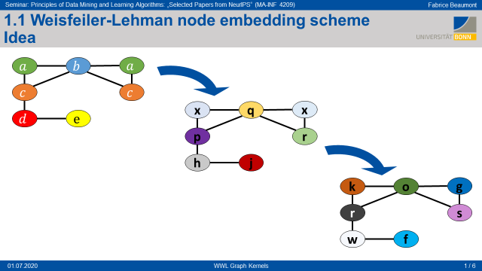
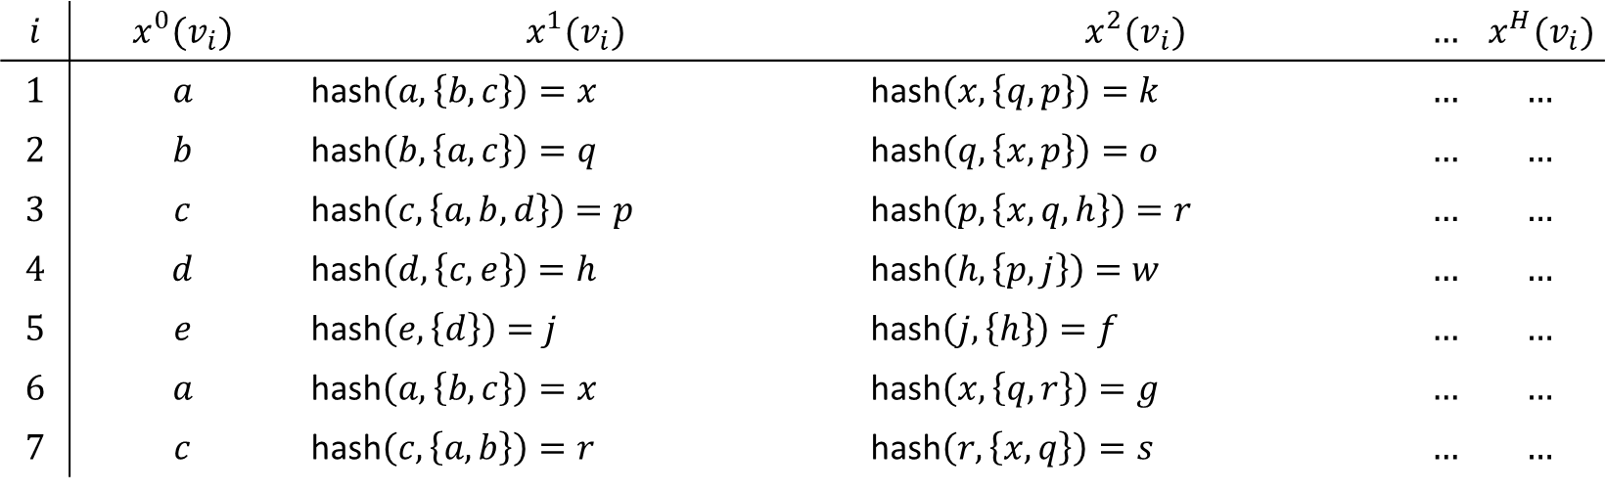
1.1 Weisfeiler-Lehman node embedding scheme Example – Node labels
$m=1$: | dimensionality of the node labels
$n_{G}=7$: | cardinality of the node set
$N(v)$: | neighbourhood of $v$
$$x^{h+1}\left(v\right)=hash(x^{h}\left(v\right), N^{h}(v))$$
$$i$$ | $$x^{0}(v_{i})$$ | $$x^{1}(v_{i})$$ | $$x^{2}(v_{i})$$ | $$…$$ | $$x^{H}(v_{i})$$
$$1$$ | $$a$$ | hash$\left(a,\left\{b, c\right\}\right)=x$ | hash$\left(x,\left\{q, p\right\}\right)=k$ | $$…$$ | $$…$$
$$2$$ | $$b$$ | hash$\left(b,\left\{a, c\right\}\right)=q$ | hash$\left(q,\left\{x, p\right\}\right)=o$ | $$…$$ | $$…$$
$$3$$ | $$c$$ | hash$\left(c,\left\{a, b,d\right\}\right)=p$ | hash$\left(p,\left\{x,q,h\right\}\right)=r$ | $$…$$ | $$…$$
$$4$$ | $$d$$ | hash$\left(d,\left\{c, e\right\}\right)=h$ | hash$\left(h,\left\{p,j\right\}\right)=w$ | $$…$$ | $$…$$
$$5$$ | $$e$$ | hash$\left(e,\left\{d\right\}\right)=j$ | hash$\left(j,\left\{h\right\}\right)=f$ | $$…$$ | $$…$$
$$6$$ | $$a$$ | hash$\left(a,\left\{b, c\right\}\right)=x$ | hash$\left(x,\left\{q,r\right\}\right)=g$ | $$…$$ | $$…$$
$$7$$ | $$c$$ | hash$\left(c,\left\{a, b\right\}\right)=r$ | hash$\left(r,\left\{x,q\right\}\right)=s$ | $$…$$ | $$…$$
5 / 6

Slide 31
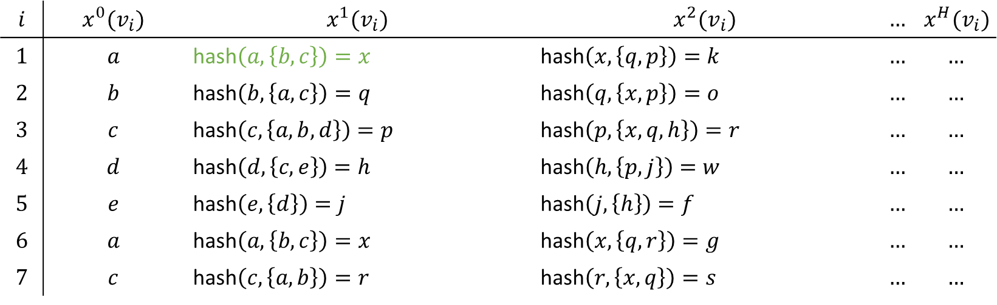
1.1 Weisfeiler-Lehman node embedding scheme Example – Node labels
$m=1$: | dimensionality of the node labels
$n_{G}=7$: | cardinality of the node set
$N(v)$: | neighbourhood of $v$
$$\left(v_{1} | a\right)$$
$$\left(v_{2} | b\right)$$
$$\left(v_{6} | a\right)$$
$$\left(v_{3} | c\right)$$
$$\left(v_{7} | c\right)$$
$$x^{h+1}\left(v\right)=hash(x^{h}\left(v\right), N^{h}(v))$$
$$\left(v_{4} | d\right)$$
$$\left(v_{5} | e\right)$$
$$i$$ | $$x^{0}(v_{i})$$ | $$x^{1}(v_{i})$$ | $$x^{2}(v_{i})$$ | $$…$$ | $$x^{H}(v_{i})$$
$$1$$ | $$a$$ | hash$\left(a,\left\{b, c\right\}\right)=x$ | hash$\left(x,\left\{q, p\right\}\right)=k$ | $$…$$ | $$…$$
$$2$$ | $$b$$ | hash$\left(b,\left\{a, c\right\}\right)=q$ | hash$\left(q,\left\{x, p\right\}\right)=o$ | $$…$$ | $$…$$
$$3$$ | $$c$$ | hash$\left(c,\left\{a, b,d\right\}\right)=p$ | hash$\left(p,\left\{x,q,h\right\}\right)=r$ | $$…$$ | $$…$$
$$4$$ | $$d$$ | hash$\left(d,\left\{c, e\right\}\right)=h$ | hash$\left(h,\left\{p,j\right\}\right)=w$ | $$…$$ | $$…$$
$$5$$ | $$e$$ | hash$\left(e,\left\{d\right\}\right)=j$ | hash$\left(j,\left\{h\right\}\right)=f$ | $$…$$ | $$…$$
$$6$$ | $$a$$ | hash$\left(a,\left\{b, c\right\}\right)=x$ | hash$\left(x,\left\{q,r\right\}\right)=g$ | $$…$$ | $$…$$
$$7$$ | $$c$$ | hash$\left(c,\left\{a, b\right\}\right)=r$ | hash$\left(r,\left\{x,q\right\}\right)=s$ | $$…$$ | $$…$$
5 / 6

Slide 32
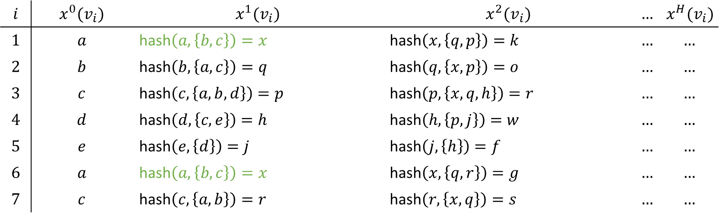
1.1 Weisfeiler-Lehman node embedding scheme Example – Node labels
$m=1$: | dimensionality of the node labels
$n_{G}=7$: | cardinality of the node set
$N(v)$: | neighbourhood of $v$
$$\left(v_{1} | a\right)$$
$$\left(v_{2} | b\right)$$
$$\left(v_{6} | a\right)$$
$$\left(v_{3} | c\right)$$
$$\left(v_{7} | c\right)$$
$$x^{h+1}\left(v\right)=hash(x^{h}\left(v\right), N^{h}(v))$$
$$\left(v_{4} | d\right)$$
$$\left(v_{5} | e\right)$$
$$i$$ | $$x^{0}(v_{i})$$ | $$x^{1}(v_{i})$$ | $$x^{2}(v_{i})$$ | $$…$$ | $$x^{H}(v_{i})$$
$$1$$ | $$a$$ | hash$\left(a,\left\{b, c\right\}\right)=x$ | hash$\left(x,\left\{q, p\right\}\right)=k$ | $$…$$ | $$…$$
$$2$$ | $$b$$ | hash$\left(b,\left\{a, c\right\}\right)=q$ | hash$\left(q,\left\{x, p\right\}\right)=o$ | $$…$$ | $$…$$
$$3$$ | $$c$$ | hash$\left(c,\left\{a, b,d\right\}\right)=p$ | hash$\left(p,\left\{x,q,h\right\}\right)=r$ | $$…$$ | $$…$$
$$4$$ | $$d$$ | hash$\left(d,\left\{c, e\right\}\right)=h$ | hash$\left(h,\left\{p,j\right\}\right)=w$ | $$…$$ | $$…$$
$$5$$ | $$e$$ | hash$\left(e,\left\{d\right\}\right)=j$ | hash$\left(j,\left\{h\right\}\right)=f$ | $$…$$ | $$…$$
$$6$$ | $$a$$ | hash$\left(a,\left\{b, c\right\}\right)=x$ | hash$\left(x,\left\{q,r\right\}\right)=g$ | $$…$$ | $$…$$
$$7$$ | $$c$$ | hash$\left(c,\left\{a, b\right\}\right)=r$ | hash$\left(r,\left\{x,q\right\}\right)=s$ | $$…$$ | $$…$$
5 / 6
Notes:
First-order neighbourhood of v_1 and v_6 are the same

Slide 33
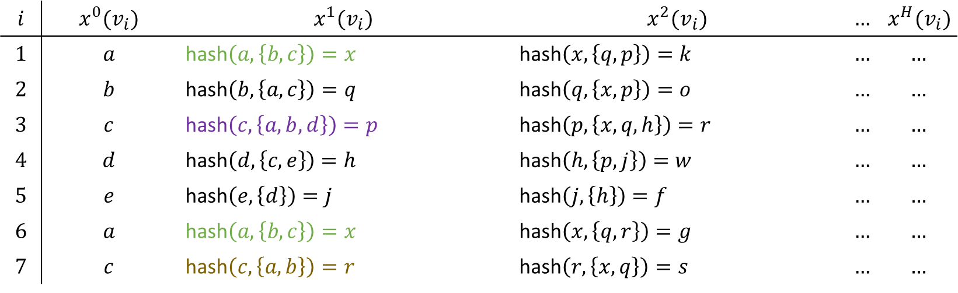
1.1 Weisfeiler-Lehman node embedding scheme Example – Node labels
$m=1$: | dimensionality of the node labels
$n_{G}=7$: | cardinality of the node set
$N(v)$: | neighbourhood of $v$
$$\left(v_{1} | a\right)$$
$$\left(v_{2} | b\right)$$
$$\left(v_{6} | a\right)$$
$$\left(v_{3} | c\right)$$
$$\left(v_{7} | c\right)$$
$$x^{h+1}\left(v\right)=hash(x^{h}\left(v\right), N^{h}(v))$$
$$\left(v_{4} | d\right)$$
$$\left(v_{5} | e\right)$$
$$i$$ | $$x^{0}(v_{i})$$ | $$x^{1}(v_{i})$$ | $$x^{2}(v_{i})$$ | $$…$$ | $$x^{H}(v_{i})$$
$$1$$ | $$a$$ | hash$\left(a,\left\{b, c\right\}\right)=x$ | hash$\left(x,\left\{q, p\right\}\right)=k$ | $$…$$ | $$…$$
$$2$$ | $$b$$ | hash$\left(b,\left\{a, c\right\}\right)=q$ | hash$\left(q,\left\{x, p\right\}\right)=o$ | $$…$$ | $$…$$
$$3$$ | $$c$$ | hash$\left(c,\left\{a, b,d\right\}\right)=p$ | hash$\left(p,\left\{x,q,h\right\}\right)=r$ | $$…$$ | $$…$$
$$4$$ | $$d$$ | hash$\left(d,\left\{c, e\right\}\right)=h$ | hash$\left(h,\left\{p,j\right\}\right)=w$ | $$…$$ | $$…$$
$$5$$ | $$e$$ | hash$\left(e,\left\{d\right\}\right)=j$ | hash$\left(j,\left\{h\right\}\right)=f$ | $$…$$ | $$…$$
$$6$$ | $$a$$ | hash$\left(a,\left\{b, c\right\}\right)=x$ | hash$\left(x,\left\{q,r\right\}\right)=g$ | $$…$$ | $$…$$
$$7$$ | $$c$$ | hash$\left(c,\left\{a, b\right\}\right)=r$ | hash$\left(r,\left\{x,q\right\}\right)=s$ | $$…$$ | $$…$$
5 / 6
Notes:
First-order neighbourhood of v_3 and v_7 are NOT the same Since they are neighbours of v_1 and v_6 – this implies that the
Second-order neighbourhoods of v_1 and v_6 are NOT the same, too: k != g

Slide 34
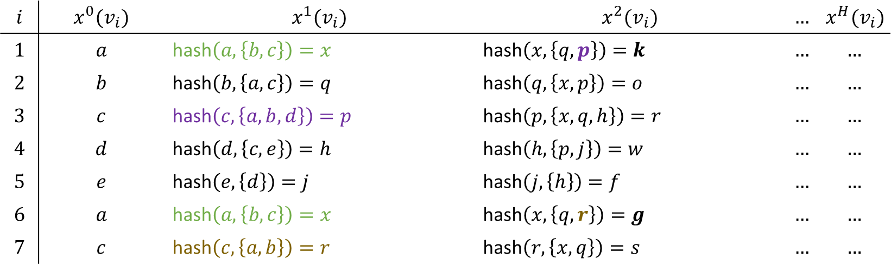
1.1 Weisfeiler-Lehman node embedding scheme Example – Node labels
$m=1$: | dimensionality of the node labels
$n_{G}=7$: | cardinality of the node set
$N(v)$: | neighbourhood of $v$
$$\left(v_{1} | a\right)$$
$$\left(v_{2} | b\right)$$
$$\left(v_{6} | a\right)$$
$$\left(v_{3} | c\right)$$
$$\left(v_{7} | c\right)$$
$$x^{h+1}\left(v\right)=hash(x^{h}\left(v\right), N^{h}(v))$$
$$\left(v_{4} | d\right)$$
$$\left(v_{5} | e\right)$$
$$i$$ | $$x^{0}(v_{i})$$ | $$x^{1}(v_{i})$$ | $$x^{2}(v_{i})$$ | $$…$$ | $$x^{H}(v_{i})$$
$$1$$ | $$a$$ | hash$\left(a,\left\{b, c\right\}\right)=x$ | hash$\left(x,\left\{q, p\right\}\right)=k$ | $$…$$ | $$…$$
$$2$$ | $$b$$ | hash$\left(b,\left\{a, c\right\}\right)=q$ | hash$\left(q,\left\{x, p\right\}\right)=o$ | $$…$$ | $$…$$
$$3$$ | $$c$$ | hash$\left(c,\left\{a, b,d\right\}\right)=p$ | hash$\left(p,\left\{x,q,h\right\}\right)=r$ | $$…$$ | $$…$$
$$4$$ | $$d$$ | hash$\left(d,\left\{c, e\right\}\right)=h$ | hash$\left(h,\left\{p,j\right\}\right)=w$ | $$…$$ | $$…$$
$$5$$ | $$e$$ | hash$\left(e,\left\{d\right\}\right)=j$ | hash$\left(j,\left\{h\right\}\right)=f$ | $$…$$ | $$…$$
$$6$$ | $$a$$ | hash$\left(a,\left\{b, c\right\}\right)=x$ | hash$\left(x,\left\{q,r\right\}\right)=g$ | $$…$$ | $$…$$
$$7$$ | $$c$$ | hash$\left(c,\left\{a, b\right\}\right)=r$ | hash$\left(r,\left\{x,q\right\}\right)=s$ | $$…$$ | $$…$$
5 / 6
Notes:
First-order neighbourhood of v_3 and v_7 are NOT the same Since they are neighbours of v_1 and v_6 – this implies that the
Second-order neighbourhoods of v_1 and v_6 are NOT the same, too: k != g

Slide 35
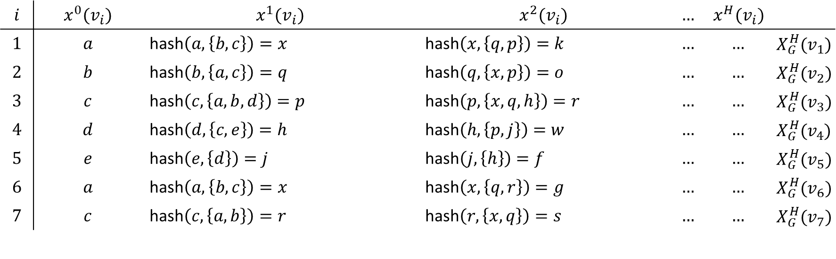
1.1 Weisfeiler-Lehman node embedding scheme Example – Node labels
$m=1$: | dimensionality of the node labels
$n_{G}=7$: | cardinality of the node set
$N(v)$: | neighbourhood of $v$
$$x^{h+1}\left(v\right)=hash(x^{h}\left(v\right), N^{h}(v))$$
$$i$$ | $$x^{0}(v_{i})$$ | $$x^{1}(v_{i})$$ | $$x^{2}(v_{i})$$ | $$…$$ | $$x^{H}(v_{i})$$
$$1$$ | $$a$$ | hash$\left(a,\left\{b, c\right\}\right)=x$ | hash$\left(x,\left\{q, p\right\}\right)=k$ | $$…$$ | $$…$$ | $$X_{G}^{H}(v_{1})$$
$$2$$ | $$b$$ | hash$\left(b,\left\{a, c\right\}\right)=q$ | hash$\left(q,\left\{x, p\right\}\right)=o$ | $$…$$ | $$…$$ | $$X_{G}^{H}(v_{2})$$
$$3$$ | $$c$$ | hash$\left(c,\left\{a, b,d\right\}\right)=p$ | hash$\left(p,\left\{x,q,h\right\}\right)=r$ | $$…$$ | $$…$$ | $$X_{G}^{H}(v_{3})$$
$$4$$ | $$d$$ | hash$\left(d,\left\{c, e\right\}\right)=h$ | hash$\left(h,\left\{p,j\right\}\right)=w$ | $$…$$ | $$…$$ | $$X_{G}^{H}(v_{4})$$
$$5$$ | $$e$$ | hash$\left(e,\left\{d\right\}\right)=j$ | hash$\left(j,\left\{h\right\}\right)=f$ | $$…$$ | $$…$$ | $$X_{G}^{H}(v_{5})$$
$$6$$ | $$a$$ | hash$\left(a,\left\{b, c\right\}\right)=x$ | hash$\left(x,\left\{q,r\right\}\right)=g$ | $$…$$ | $$…$$ | $$X_{G}^{H}(v_{6})$$
$$7$$ | $$c$$ | hash$\left(c,\left\{a, b\right\}\right)=r$ | hash$\left(r,\left\{x,q\right\}\right)=s$ | $$…$$ | $$…$$ | $$X_{G}^{H}(v_{7})$$
5 / 6
Notes:
$X_{G}^{h}$ = Feature node vector of graph G at iteration h (contains labels with information about the h-th-order neighbourhoods)

Slide 36

1.1 Weisfeiler-Lehman node embedding scheme Example – Node labels
$m=1$: | dimensionality of the node labels
$n_{G}=7$: | cardinality of the node set
$N(v)$: | neighbourhood of $v$
$$x^{h+1}\left(v\right)=hash(x^{h}\left(v\right), N^{h}(v))$$
$$f_{WL}^{H}(G)$$
$$i$$ | $$x^{0}(v_{i})$$ | $$x^{1}(v_{i})$$ | $$x^{2}(v_{i})$$ | $$…$$ | $$x^{H}(v_{i})$$
$$1$$ | $$a$$ | hash$\left(a,\left\{b, c\right\}\right)=x$ | hash$\left(x,\left\{q, p\right\}\right)=k$ | $$…$$ | $$…$$ | $$X_{G}^{H}(v_{1})$$
$$2$$ | $$b$$ | hash$\left(b,\left\{a, c\right\}\right)=q$ | hash$\left(q,\left\{x, p\right\}\right)=o$ | $$…$$ | $$…$$ | $$X_{G}^{H}(v_{2})$$
$$3$$ | $$c$$ | hash$\left(c,\left\{a, b,d\right\}\right)=p$ | hash$\left(p,\left\{x,q,h\right\}\right)=r$ | $$…$$ | $$…$$ | $$X_{G}^{H}(v_{3})$$
$$4$$ | $$d$$ | hash$\left(d,\left\{c, e\right\}\right)=h$ | hash$\left(h,\left\{p,j\right\}\right)=w$ | $$…$$ | $$…$$ | $$X_{G}^{H}(v_{4})$$
$$5$$ | $$e$$ | hash$\left(e,\left\{d\right\}\right)=j$ | hash$\left(j,\left\{h\right\}\right)=f$ | $$…$$ | $$…$$ | $$X_{G}^{H}(v_{5})$$
$$6$$ | $$a$$ | hash$\left(a,\left\{b, c\right\}\right)=x$ | hash$\left(x,\left\{q,r\right\}\right)=g$ | $$…$$ | $$…$$ | $$X_{G}^{H}(v_{6})$$
$$7$$ | $$c$$ | hash$\left(c,\left\{a, b\right\}\right)=r$ | hash$\left(r,\left\{x,q\right\}\right)=s$ | $$…$$ | $$…$$ | $$X_{G}^{H}(v_{7})$$
5 / 6
Notes:
$X_{G}^{h}$ = Feature node vector of graph G at iteration h (contains labels with information about the h-th-order neighbourhoods)

Slide 37
2.2 Graph Wasserstein distance Motivation
TODO: insert inhaltsverzeichnis slide
5 / 6
Notes:
TODO: Visualization and example of the Wasserstein distance

Slide 38





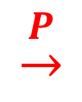
2.2 Graph Wasserstein distance Motivation
Transport plan:
$$A$$
$$\underset{→}{P}$$
$$B$$
5 / 6
Notes:
TODO: Visualization and example of the Wasserstein distance

Slide 39
2.2 Graph Wasserstein distance Motivation
Transport plan:
$$\underset{→}{P}$$
5 / 6
Notes:
TODO: Visualization and example of the Wasserstein distance

Slide 40


2.2 Graph Wasserstein distance Motivation
$$i$$
$$j$$
5 / 6
Notes:
TODO: Visualization and example of the Wasserstein distance

Slide 41
2.2 Graph Wasserstein distance Motivation
$$i$$
$$j$$
5 / 6
Notes:
TODO: Visualization and example of the Wasserstein distance

Slide 42


2.2 Graph Wasserstein distance Motivation
$$p_{i,j}$$
$$i$$
$$j$$
5 / 6
Notes:
TODO: Visualization and example of the Wasserstein distance

Slide 43
1.1 Weisfeiler-Lehman node embedding scheme Idea
$$a$$
$$b$$
$$a$$
$$c$$
$$c$$
x
q
x
$$d$$
$$e$$
$$Step 0$$
p
r
h
j
$$Step 1$$
k
o
g
r
s
w
f
$$…$$
$$Step 2$$
1 / 6

Slide 44
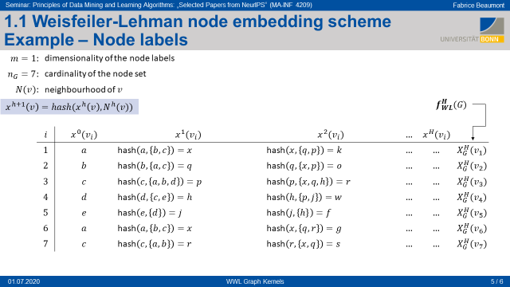







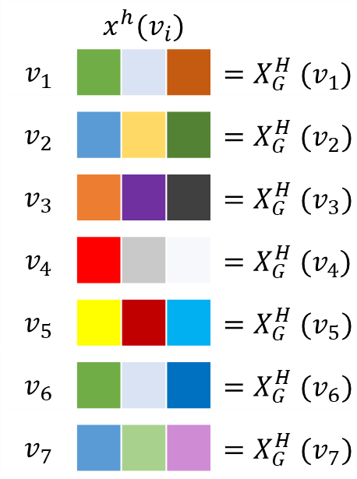


1.1 Weisfeiler-Lehman node embedding scheme Idea
$$a$$
$$b$$
$$a$$
x
q
x
k
o
g
$$c$$
$$c$$
p
r
r
s
$$…$$
$$d$$
$$e$$
h
j
w
f
 | $$x^{h}(v_{i})$$
$$v_{1}$$ |  |  |  | $${=X}_{G}^{H}(v_{1})$$
$$v_{2}$$ |  |  |  | $${=X}_{G}^{H}(v_{2})$$
$$v_{3}$$ |  |  |  | $${=X}_{G}^{H}(v_{3})$$
$$v_{4}$$ |  |  |  | $${=X}_{G}^{H}(v_{4})$$
$$v_{5}$$ |  |  |  | $${=X}_{G}^{H}(v_{5})$$
$$v_{6}$$ |  |  |  | $${=X}_{G}^{H}(v_{6})$$
$$v_{7}$$ |  |  |  | $${=X}_{G}^{H}(v_{7})$$
$$(H=2)$$
1 / 6

Slide 45









1.1 Weisfeiler-Lehman node embedding scheme Idea
$$G$$
 | $$x^{h}(v_{i})$$
$$v_{1}$$ |  |  |  | $${=X}_{G}^{H}(v_{1})$$
$$v_{2}$$ |  |  |  | $${=X}_{G}^{H}(v_{2})$$
$$v_{3}$$ |  |  |  | $${=X}_{G}^{H}(v_{3})$$
$$v_{4}$$ |  |  |  | $${=X}_{G}^{H}(v_{4})$$
$$v_{5}$$ |  |  |  | $${=X}_{G}^{H}(v_{5})$$
$$v_{6}$$ |  |  |  | $${=X}_{G}^{H}(v_{6})$$
$$v_{7}$$ |  |  |  | $${=X}_{G}^{H}(v_{7})$$
$$v_{1}$$
$$v_{2}$$
$$v_{6}$$
$$v_{3}$$
$$v_{7}$$
$$v_{4}$$
$$v_{5}$$
1 / 6

Slide 46


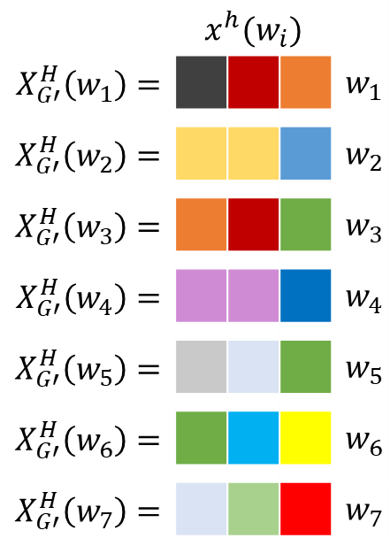






1.1 Weisfeiler-Lehman node embedding scheme Idea
$$G$$
$$G′$$
 | $$x^{h}(v_{i})$$
$$v_{1}$$ |  |  |  | $${=X}_{G}^{H}(v_{1})$$
$$v_{2}$$ |  |  |  | $${=X}_{G}^{H}(v_{2})$$
$$v_{3}$$ |  |  |  | $${=X}_{G}^{H}(v_{3})$$
$$v_{4}$$ |  |  |  | $${=X}_{G}^{H}(v_{4})$$
$$v_{5}$$ |  |  |  | $${=X}_{G}^{H}(v_{5})$$
$$v_{6}$$ |  |  |  | $${=X}_{G}^{H}(v_{6})$$
$$v_{7}$$ |  |  |  | $${=X}_{G}^{H}(v_{7})$$
 | $$x^{h}(w_{i})$$
$$X_{G′}^{H}\left(w_{1}\right)=$$ |  |  |  | $$w_{1}$$
$$X_{G′}^{H}\left(w_{2}\right)=$$ |  |  |  | $$w_{2}$$
$$X_{G′}^{H}\left(w_{3}\right)=$$ |  |  |  | $$w_{3}$$
$$X_{G′}^{H}\left(w_{4}\right)=$$ |  |  |  | $$w_{4}$$
$$X_{G′}^{H}\left(w_{5}\right)=$$ |  |  |  | $$w_{5}$$
$$X_{G′}^{H}\left(w_{6}\right)=$$ |  |  |  | $$w_{6}$$
$$X_{G′}^{H}\left(w_{7}\right)=$$ |  |  |  | $$w_{7}$$
$$v_{1}$$
$$v_{2}$$
$$v_{6}$$
$$w_{1}$$
$$w_{2}$$
$$w_{3}$$
$$v_{3}$$
$$v_{7}$$
$$w_{4}$$
$$w_{5}$$
$$w_{6}$$
$$v_{4}$$
$$v_{5}$$
$$w_{7}$$
1 / 6

Slide 47



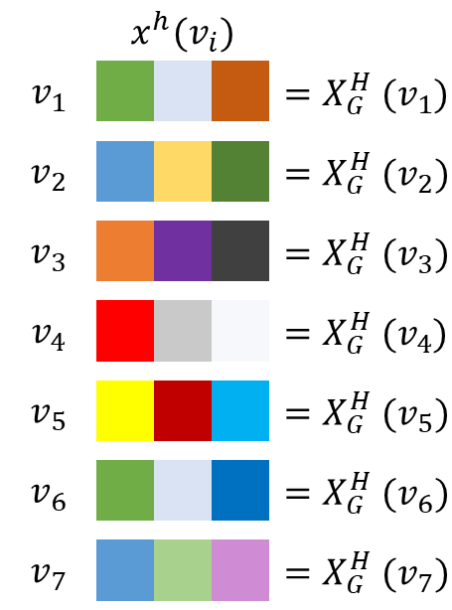
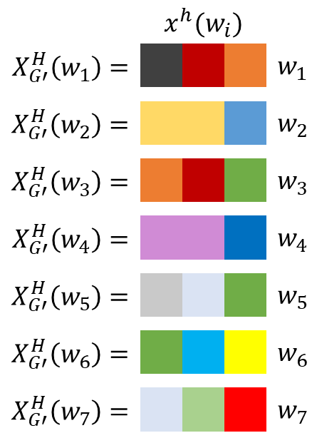
1.1 Weisfeiler-Lehman node embedding scheme Idea
 | $$x^{h}(v_{i})$$
$$v_{1}$$ |  |  |  | $${=X}_{G}^{H}(v_{1})$$
$$v_{2}$$ |  |  |  | $${=X}_{G}^{H}(v_{2})$$
$$v_{3}$$ |  |  |  | $${=X}_{G}^{H}(v_{3})$$
$$v_{4}$$ |  |  |  | $${=X}_{G}^{H}(v_{4})$$
$$v_{5}$$ |  |  |  | $${=X}_{G}^{H}(v_{5})$$
$$v_{6}$$ |  |  |  | $${=X}_{G}^{H}(v_{6})$$
$$v_{7}$$ |  |  |  | $${=X}_{G}^{H}(v_{7})$$
 | $$x^{h}(w_{i})$$
$$X_{G′}^{H}\left(w_{1}\right)=$$ |  |  |  | $$w_{1}$$
$$X_{G′}^{H}\left(w_{2}\right)=$$ |  |  |  | $$w_{2}$$
$$X_{G′}^{H}\left(w_{3}\right)=$$ |  |  |  | $$w_{3}$$
$$X_{G′}^{H}\left(w_{4}\right)=$$ |  |  |  | $$w_{4}$$
$$X_{G′}^{H}\left(w_{5}\right)=$$ |  |  |  | $$w_{5}$$
$$X_{G′}^{H}\left(w_{6}\right)=$$ |  |  |  | $$w_{6}$$
$$X_{G′}^{H}\left(w_{7}\right)=$$ |  |  |  | $$w_{7}$$
1 / 6

Slide 48
1.1 Weisfeiler-Lehman node embedding scheme Idea
$$G$$
$$G′$$
 | $$x^{h}(v_{i})$$
$$v_{1}$$ |  |  |  | $${=X}_{G}^{H}(v_{1})$$
$$v_{2}$$ |  |  |  | $${=X}_{G}^{H}(v_{2})$$
$$v_{3}$$ |  |  |  | $${=X}_{G}^{H}(v_{3})$$
$$v_{4}$$ |  |  |  | $${=X}_{G}^{H}(v_{4})$$
$$v_{5}$$ |  |  |  | $${=X}_{G}^{H}(v_{5})$$
$$v_{6}$$ |  |  |  | $${=X}_{G}^{H}(v_{6})$$
$$v_{7}$$ |  |  |  | $${=X}_{G}^{H}(v_{7})$$
 | $$x^{h}(w_{i})$$
$$X_{G′}^{H}\left(w_{1}\right)=$$ |  |  |  | $$w_{1}$$
$$X_{G′}^{H}\left(w_{2}\right)=$$ |  |  |  | $$w_{2}$$
$$X_{G′}^{H}\left(w_{3}\right)=$$ |  |  |  | $$w_{3}$$
$$X_{G′}^{H}\left(w_{4}\right)=$$ |  |  |  | $$w_{4}$$
$$X_{G′}^{H}\left(w_{5}\right)=$$ |  |  |  | $$w_{5}$$
$$X_{G′}^{H}\left(w_{6}\right)=$$ |  |  |  | $$w_{6}$$
$$X_{G′}^{H}\left(w_{7}\right)=$$ |  |  |  | $$w_{7}$$
$$v_{1}$$
$$v_{2}$$
$$v_{6}$$
$$w_{1}$$
$$w_{2}$$
$$w_{3}$$
$$v_{3}$$
$$v_{7}$$
$$w_{4}$$
$$w_{5}$$
$$w_{6}$$
$$v_{4}$$
$$v_{5}$$
$$w_{7}$$
1 / 6

Slide 49



1.1 Weisfeiler-Lehman node embedding scheme Idea
$$G$$
$$G′$$
 | $$x^{h}(v_{i})$$
$$v_{1}$$ |  |  |  | $${=X}_{G}^{H}(v_{1})$$
$$v_{2}$$ |  |  |  | $${=X}_{G}^{H}(v_{2})$$
$$v_{3}$$ |  |  |  | $${=X}_{G}^{H}(v_{3})$$
$$v_{4}$$ |  |  |  | $${=X}_{G}^{H}(v_{4})$$
$$v_{5}$$ |  |  |  | $${=X}_{G}^{H}(v_{5})$$
$$v_{6}$$ |  |  |  | $${=X}_{G}^{H}(v_{6})$$
$$v_{7}$$ |  |  |  | $${=X}_{G}^{H}(v_{7})$$
$$p_{v_{1},w_{1}}$$
 | $$x^{h}(w_{i})$$
$$X_{G′}^{H}\left(w_{1}\right)=$$ |  |  |  | $$w_{1}$$
$$X_{G′}^{H}\left(w_{2}\right)=$$ |  |  |  | $$w_{2}$$
$$X_{G′}^{H}\left(w_{3}\right)=$$ |  |  |  | $$w_{3}$$
$$X_{G′}^{H}\left(w_{4}\right)=$$ |  |  |  | $$w_{4}$$
$$X_{G′}^{H}\left(w_{5}\right)=$$ |  |  |  | $$w_{5}$$
$$X_{G′}^{H}\left(w_{6}\right)=$$ |  |  |  | $$w_{6}$$
$$X_{G′}^{H}\left(w_{7}\right)=$$ |  |  |  | $$w_{7}$$
$$v_{1}$$
$$v_{2}$$
$$v_{6}$$
$$p_{v_{1},w_{2}}$$
$$w_{1}$$
$$w_{2}$$
$$w_{3}$$
$$p_{v_{1},w_{3}}$$
$$v_{3}$$
$$v_{7}$$
…
$$w_{4}$$
$$w_{5}$$
$$w_{6}$$
$$v_{4}$$
$$v_{5}$$
$$w_{7}$$
1 / 6

Slide 50
1.1 Weisfeiler-Lehman node embedding scheme Idea
$$G$$
$$G′$$
 | $$x^{h}(v_{i})$$
$$v_{1}$$ |  |  |  | $${=X}_{G}^{H}(v_{1})$$
$$v_{2}$$ |  |  |  | $${=X}_{G}^{H}(v_{2})$$
$$v_{3}$$ |  |  |  | $${=X}_{G}^{H}(v_{3})$$
$$v_{4}$$ |  |  |  | $${=X}_{G}^{H}(v_{4})$$
$$v_{5}$$ |  |  |  | $${=X}_{G}^{H}(v_{5})$$
$$v_{6}$$ |  |  |  | $${=X}_{G}^{H}(v_{6})$$
$$v_{7}$$ |  |  |  | $${=X}_{G}^{H}(v_{7})$$
 | $$x^{h}(w_{i})$$
$$X_{G′}^{H}\left(w_{1}\right)=$$ |  |  |  | $$w_{1}$$
$$X_{G′}^{H}\left(w_{2}\right)=$$ |  |  |  | $$w_{2}$$
$$X_{G′}^{H}\left(w_{3}\right)=$$ |  |  |  | $$w_{3}$$
$$X_{G′}^{H}\left(w_{4}\right)=$$ |  |  |  | $$w_{4}$$
$$X_{G′}^{H}\left(w_{5}\right)=$$ |  |  |  | $$w_{5}$$
$$X_{G′}^{H}\left(w_{6}\right)=$$ |  |  |  | $$w_{6}$$
$$X_{G′}^{H}\left(w_{7}\right)=$$ |  |  |  | $$w_{7}$$
$$v_{1}$$
$$v_{2}$$
$$v_{6}$$
$$w_{1}$$
$$w_{2}$$
$$w_{3}$$
$$v_{3}$$
$$v_{7}$$
$$w_{4}$$
$$w_{5}$$
$$w_{6}$$
$$v_{4}$$
$$v_{5}$$
$$w_{7}$$
1 / 6

Slide 51
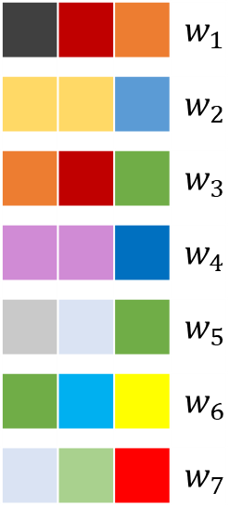
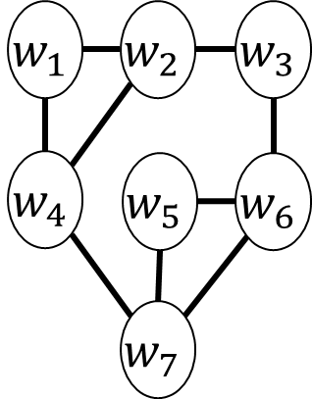
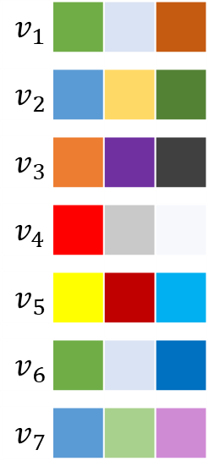



1.1 Weisfeiler-Lehman node embedding scheme Idea
$$G′$$
$$G$$
1 / 6

Slide 52

1.1 Weisfeiler-Lehman node embedding scheme Idea
$$G′$$
$$p_{v_{1},w_{1}}$$
$$G$$
1 / 6

Slide 53

1.1 Weisfeiler-Lehman node embedding scheme Idea
$$G′$$
$$p_{v_{1},w_{1}}$$ | $$p_{v_{1},w_{2}}$$
$$G$$
1 / 6

Slide 54



1.1 Weisfeiler-Lehman node embedding scheme Idea
$$G′$$
$$p_{v_{1},w_{1}}$$ | $$p_{v_{1},w_{2}}$$ | $$p_{v_{1},w_{3}}$$ | $$p_{v_{1},w_{4}}$$ | $$p_{v_{1},w_{5}}$$ | $$p_{v_{1},w_{6}}$$ | $$p_{v_{1},w_{7}}$$
$$p_{v_{2},w_{1}}$$ | $$p_{v_{2},w_{2}}$$ | $$p_{v_{2},w_{3}}$$ | $$p_{v_{2},w_{4}}$$ | …
$$G$$
Transportation plan
$$P$$
$$∈ℝ^{n_{G}×n_{G′}}$$
1 / 6

Slide 55


2.1 Ground disance between nodes
 | $$x^{h}(.)$$
$$v_{6}$$ |  |  |  | $$X_{G}^{H}(v_{6})$$
$$v_{6}$$ |  |  |  | $$X_{G}^{H}(w_{6})$$
 | $$=$$ | $$≠$$ | $$≠$$
 | 0 | 1 | 1 | $$⟹d_{Ham}=\frac{1}{3}2$$
Notes:
Note: p(x,y) = 1 if inequal, since we would like to have a greater distance
For objects that are less equal

Slide 56


2.1 Ground disance between nodes
 | $$x^{h}(.)$$
$$v_{6}$$ |  |  |  | $$X_{G}^{H}(v_{6})$$
$$v_{6}$$ |  |  |  | $$X_{G}^{H}(w_{6})$$
 | $$=$$ | $$≠$$ | $$≠$$
 | 0 | 1 | 1 | $$⟹d_{Ham}=\frac{1}{3}2$$
$$d_{Ham}\left(X_{G}^{H}(v_{6}),X_{G}^{H}(w_{6})\right)=\frac{1}{H+1}\sum_{h=0}^{H}{ρ(x^{h}(v_{6}),x^{h}(w_{6}))}$$
$$ρ(x,y)=\left\{\begin{aligned}1 \text{if} x≠y \\ 0 \text{if} x=y\end{aligned}\right.$$
Notes:
Note: p(x,y) = 1 if inequal, since we would like to have a greater distance
For objects that are less equal

Slide 57


2.1 Ground disance between nodes
 | $$x^{h}(.)$$
$$v_{6}$$ |  |  |  | $$X_{G}^{H}(v_{6})$$
$$v_{6}$$ |  |  |  | $$X_{G}^{H}(w_{6})$$
 | $$=$$ | $$≠$$ | $$≠$$
 | 0 | 1 | 1 | $$⟹d_{Ham}=\frac{1}{3}2$$
$$d_{Ham}\left(X_{G}^{H}(v_{6}),X_{G}^{H}(w_{6})\right)=\frac{1}{H+1}\sum_{h=0}^{H}{ρ(x^{h}(v_{6}),x^{h}(w_{6}))}$$
$$ρ(x,y)=\left\{\begin{aligned}1 \text{if} x≠y \\ 0 \text{if} x=y\end{aligned}\right.$$
DISCRETE node labels | CONTINUOUS node labels
Normalised Hamming distance: | Euclidean distance:
$$d_{Ham}\left(v,v′\right)=\frac{1}{H+1}\sum_{i=0}^{H}{ρ(v_{i},{v^{′}}_{i})}$$
$$d_{E}\left(v,v′\right)={\left\|v−v′\right\|}_{2}$$
Notes:
Note: p(x,y) = 1 if inequal, since we would like to have a greater distance
For objects that are less equal

Slide 58



1.1 Weisfeiler-Lehman node embedding scheme Idea
$$p_{v_{1},w_{1}}$$ | $$p_{v_{1},w_{2}}$$ | $$p_{v_{1},w_{3}}$$ | $$p_{v_{1},w_{4}}$$ | $$p_{v_{1},w_{5}}$$ | $$p_{v_{1},w_{6}}$$ | $$p_{v_{1},w_{7}}$$
$$p_{v_{2},w_{1}}$$ | $$p_{v_{2},w_{2}}$$ | $$p_{v_{2},w_{3}}$$ | $$p_{v_{2},w_{4}}$$ | …
Transportation Plan Matrix
$$P$$
$$∈ℝ^{n_{G}×n_{G′}}$$
1 / 6

Slide 59



1.1 Weisfeiler-Lehman node embedding scheme Idea
$$p_{v_{1},w_{1}}$$ | $$p_{v_{1},w_{2}}$$ | $$p_{v_{1},w_{3}}$$ | $$p_{v_{1},w_{4}}$$ | $$p_{v_{1},w_{5}}$$ | $$p_{v_{1},w_{6}}$$ | $$p_{v_{1},w_{7}}$$
$$p_{v_{2},w_{1}}$$ | $$p_{v_{2},w_{2}}$$ | $$p_{v_{2},w_{3}}$$ | $$p_{v_{2},w_{4}}$$ | …
Transportation Plan Matrix
$$P$$
$$d_{v_{1},w_{1}}$$ | $$d_{v_{1},w_{2}}$$ | $$d_{v_{1},w_{3}}$$ | $$d_{v_{1},w_{4}}$$ | $$d_{v_{1},w_{5}}$$ | $$d_{v_{1},w_{6}}$$ | $$d_{v_{1},w_{7}}$$
$$d_{v_{2},w_{1}}$$ | $$d_{v_{2},w_{2}}$$ | $$d_{v_{2},w_{3}}$$ | $$d_{v_{2},w_{4}}$$ | …
Distance Matrix
$$D$$
$$∈ℝ^{n_{G}×n_{G′}}$$
$$∈ℝ^{n_{G}×n_{G′}}$$
1 / 6

Slide 60


1.1 Weisfeiler-Lehman node embedding scheme Idea
$$W_{1}\left(f(G),f(G^{′})\right) :=\min_{P}{\sum_{\begin{aligned}v∈G, \\ w∈G′\end{aligned}}{p_{v,w} d\left(v,w\right)}}$$
1 / 6

Slide 61

1.1 Weisfeiler-Lehman node embedding scheme Idea
$$W_{1}\left(f(G),f(G^{′})\right) :=\min_{P}{\sum_{\begin{aligned}v∈G, \\ w∈G′\end{aligned}}{p_{v,w} d\left(v,w\right)}}$$
$:=\min_{P∈Γ(f(G),f(G^{′}))}\left\langle P,D\right\rangle$
1 / 6

Slide 62

3 Kernel definition
Use a Laplacian kernel:
$$K_{WWL}=e^{−λW_{1}\left(f(G),f(G^{′})\right)}$$
5 / 6
Notes:
Laplacian kernel:
- Favourable conditions for positive definiteness in case of non-Euclidean distances

Slide 63

3 Kernel definition
DISCRETE node labels | CONTINUOUS node labels
The kernel is positive definite for all $λ>0$ | ?
Open problem
5 / 6

Slide 64

3 Kernel definition
DISCRETE node labels | CONTINUOUS node labels
Positive definite for all $λ>0$ SVM | Positive definite? Workaround: RKKS (reproducing kernel Krein spaces) KSVM (Krein SVM)
Open problem
5 / 6
Notes:
RKKS = Generalisation of reproducing kernel Hilbert spaces

Slide 65







2.2 Graph Wasserstein distance
2
1
$$W_{1}\left(f(G),f(G^{′})\right)=\min_{P∈Γ(f(G),f(G^{′}))}\left\langle P,D\right\rangle$$
$$f_{WL}^{H}:G→ℝ^{n_{G}×m(H+1)}$$
3
$$G,G^{′}$$
$$K_{WWL}=e^{−λW_{1}\left(f(G),f(G^{′})\right)}$$
5 / 6
Notes:
TODO: Visualization and example of the Wasserstein distance

Slide 66
Experimental evaluation
DISCRETE node labels | CONTINUOUS node labels
Competitive with best graph kernel | Outperforms all state-of-the art graph kernels
5 / 6

Slide 67


Experimental evaluation
5 / 6

Slide 68
Thank you for your attention!

Slide 69
Appendix Other slides

Slide 70

















1.1 Weisfeiler-Lehman node embedding scheme Example – Attribute labels
$$a^{h+1}\left(v\right)=\frac{1}{2}\left(a^{h}\left(v\right)+\frac{1}{deg⁡(v)}\sum_{u∈N(v)}{w(\left(u,v\right))}a^{h}\left(u\right)\right)$$
$$\left(v_{1} | 0.5\right)$$
$$0.9$$
$$\left(v_{2} | 1138\right)$$
$$0.9$$
$$\left(v_{6} | 0.5\right)$$
$$13$$
$$13$$
$$\left(v_{3} | 42\right)$$
$$110$$
$$110$$
$$\left(v_{7} | 42\right)$$
$$0.25$$
$$\left(v_{4} | 17\right)$$
$$7$$
$$\left(v_{5} | 73\right)$$
$$i$$ | $$l^{0}(v_{i})$$ | $$l^{1}(v_{i})$$ | $$…$$ | $$l^{H}(v_{i})$$
$$1$$ | $$0.5$$ |  | $$…$$ | $$…$$
$$2$$ | $$42$$ |  | $$…$$ | $$…$$
$$3$$ | $$1138$$ |  | $$…$$ | $$…$$
$$4$$ | $$17$$ |  | $$…$$ | $$…$$
$$5$$ | $$73$$ |  | $$…$$ | $$…$$
$$6$$ | $$0.5$$ |  | $$…$$ | $$…$$
$$7$$ | $$42$$ |  | $$…$$ | $$…$$
5 / 6

Slide 71


1.1 Weisfeiler-Lehman node embedding scheme Example – Attribute labels
$$a^{h+1}\left(v\right)=\frac{1}{2}\left(a^{h}\left(v\right)+\frac{1}{deg⁡(v)}\sum_{u∈N(v)}{w(\left(u,v\right))}a^{h}\left(u\right)\right)$$
$$\left(v_{1} | 392.8\right)$$
$$0.9$$
$$\left(v_{2} | 1138\right)$$
$$0.9$$
$$\left(v_{6} | 0.5\right)$$
$$13$$
$$13$$
$$\left(v_{3} | 42\right)$$
$$110$$
$$110$$
$$\left(v_{7} | 42\right)$$
$$0.25$$
$$\left(v_{4} | 17\right)$$
$$7$$
$$\left(v_{5} | 73\right)$$
$$i$$ | $$l^{0}(v_{i})$$ | $$l^{1}(v_{i})$$ | $$…$$ | $$l^{H}(v_{i})$$
$$1$$ | $$0.5$$ | $$1/2\left(0.5+1/2\left[0.9∗1138+13∗42\right]\right)=392.8$$ | $$…$$ | $$…$$
$$2$$ | $$42$$ |  | $$…$$ | $$…$$
$$3$$ | $$1138$$ |  | $$…$$ | $$…$$
$$4$$ | $$17$$ |  | $$…$$ | $$…$$
$$5$$ | $$73$$ |  | $$…$$ | $$…$$
$$6$$ | $$0.5$$ |  | $$…$$ | $$…$$
$$7$$ | $$42$$ |  | $$…$$ | $$…$$
5 / 6

Slide 72
















1.1 Weisfeiler-Lehman node embedding scheme Example – Attribute labels
$$a^{h+1}\left(v\right)=\frac{1}{2}\left(a^{h}\left(v\right)+\frac{1}{deg⁡(v)}\sum_{u∈N(v)}{w(\left(u,v\right))}a^{h}\left(u\right)\right)$$
$$\left(v_{1} | 392.8\right)$$
$$0.9$$
$$\left(v_{2} | 1724\right)$$
$$0.9$$
$$\left(v_{6} | 0.5\right)$$
$$13$$
$$13$$
$$\left(v_{3} | 20886\right)$$
$$110$$
$$110$$
$$\left(v_{7} | 42\right)$$
$$0.25$$
$$\left(v_{4} | 138.8\right)$$
$$7$$
$$\left(v_{5} | 96\right)$$
$$i$$ | $$a^{0}(v_{i})$$ | $$a^{1}(v_{i})$$ | $$…$$ | $$a^{H}(v_{i})$$
$$1$$ | $$0.5$$ | $$1/2\left(0.5+1/2\left[0.9∗1138+13∗42\right]\right)=392.8$$ | $$…$$ | $$…$$
$$2$$ | $$42$$ | $$1/2\left(42+1/3\left[13∗0.5+110∗1138+0.25∗17\right]\right)=20886.125$$ | $$…$$ | $$…$$
$$3$$ | $$1138$$ | $$1/2\left(1138+1/4\left[0.9∗0.5+110∗42+0.9∗0.5+110∗42\right]\right)=1724.1125$$ | $$…$$ | $$…$$
$$4$$ | $$17$$ | $$1/2\left(17+1/2\left[0.25∗42+7∗73\right]\right)=138.875$$ | $$…$$ | $$…$$
$$5$$ | $$73$$ | $$1/2\left(73+1/1\left[7∗17\right]\right)=96$$ | $$…$$ | $$…$$
$$6$$ | $$0.5$$ |  | $$…$$ | $$…$$
$$7$$ | $$42$$ |  | $$…$$ | $$…$$
5 / 6

Slide 73



1.1 Weisfeiler-Lehman node embedding scheme Example – Attribute labels
$$a^{h+1}\left(v\right)=\frac{1}{2}\left(a^{h}\left(v\right)+\frac{1}{deg⁡(v)}\sum_{u∈N(v)}{w(\left(u,v\right))}a^{h}\left(u\right)\right)$$
$$\left(v_{1} | 392.8\right)$$
$$0.9$$
$$\left(v_{2} | 1724\right)$$
$$0.9$$
$$\left(v_{6} | 392.8\right)$$
$$13$$
$$13$$
$$\left(v_{3} | 20886\right)$$
$$110$$
$$110$$
$$\left(v_{7} | 31317\right)$$
$$0.25$$
$$\left(v_{4} | 138.8\right)$$
$$7$$
$$\left(v_{5} | 96\right)$$
$$i$$ | $$a^{0}(v_{i})$$ | $$a^{1}(v_{i})$$ | $$…$$ | $$a^{H}(v_{i})$$
$$1$$ | $$0.5$$ | $$1/2\left(0.5+1/2\left[0.9∗1138+13∗42\right]\right)=392.8$$ | $$…$$ | $$…$$
$$2$$ | $$42$$ | $$1/2\left(42+1/3\left[13∗0.5+110∗1138+0.25∗17\right]\right)=20886.125$$ | $$…$$ | $$…$$
$$3$$ | $$1138$$ | $$1/2\left(1138+1/4\left[0.9∗0.5+110∗42+0.9∗0.5+110∗42\right]\right)=1724.1125$$ | $$…$$ | $$…$$
$$4$$ | $$17$$ | $$1/2\left(17+1/2\left[0.25∗42+7∗73\right]\right)=138.875$$ | $$…$$ | $$…$$
$$5$$ | $$73$$ | $$1/2\left(73+1/1\left[7∗17\right]\right)=96$$ | $$…$$ | $$…$$
$$6$$ | $$0.5$$ | $$1/2\left(0.5+1/2\left[0.9∗1138+13∗42\right]\right)=392.8$$ | $$…$$ | $$…$$
$$7$$ | $$42$$ | $$1/2\left(42+1/2\left[13∗0.5+110∗1138\right]\right)=31317.625$$ | $$…$$ | $$…$$
5 / 6

Slide 74
1.1 Weisfeiler-Lehman node embedding scheme Example – Attribute labels
$$a^{h+1}\left(v\right)=\frac{1}{2}\left(a^{h}\left(v\right)+\frac{1}{deg⁡(v)}\sum_{u∈N(v)}{w(\left(u,v\right))}a^{h}\left(u\right)\right)$$
$$\left(v_{1} | 392.8\right)$$
$$0.9$$
$$\left(v_{2} | 1724\right)$$
$$0.9$$
$$\left(v_{6} | 392.8\right)$$
$$13$$
$$13$$
$$\left(v_{3} | 20886\right)$$
$$110$$
$$110$$
$$\left(v_{7} | 31317\right)$$
$$0.25$$
$$\left(v_{4} | 138.8\right)$$
$$7$$
$$\left(v_{5} | 96\right)$$
$$i$$ | $$a^{0}(v_{i})$$ | $$a^{1}(v_{i})$$ | $$…$$ | $$a^{H}(v_{i})$$
$$1$$ | $$0.5$$ | $$1/2\left(0.5+1/2\left[0.9∗1138+13∗42\right]\right)=392.8$$ | $$…$$ | $$…$$
$$2$$ | $$42$$ | $$1/2\left(42+1/3\left[13∗0.5+110∗1138+0.25∗17\right]\right)=20886.125$$ | $$…$$ | $$…$$
$$3$$ | $$1138$$ | $$1/2\left(1138+1/4\left[0.9∗0.5+110∗42+0.9∗0.5+110∗42\right]\right)=1724.1125$$ | $$…$$ | $$…$$
$$4$$ | $$17$$ | $$1/2\left(17+1/2\left[0.25∗42+7∗73\right]\right)=138.875$$ | $$…$$ | $$…$$
$$5$$ | $$73$$ | $$1/2\left(73+1/1\left[7∗17\right]\right)=96$$ | $$…$$ | $$…$$
$$6$$ | $$0.5$$ | $$1/2\left(0.5+1/2\left[0.9∗1138+13∗42\right]\right)=392.8$$ | $$…$$ | $$…$$
$$7$$ | $$42$$ | $$1/2\left(42+1/2\left[13∗0.5+110∗1138\right]\right)=31317.625$$ | $$…$$ | $$…$$
5 / 6

Slide 75


2.2 Wasserstein distance -$L^{p}$
$p∈[1,∞)$: | parameter for the $L^{p}$ Wasserstein distance
$σ,μ$: | probability distributions on a metric space $M$
$d:ℝ^{m}xℝ^{m}→ℝ^{m}$: | ground distance (on $M$)
$Γ(σ,μ)$: | set of all transportaion plans over $MxM$ (with marginals $σ$ and $μ$ on the first and second factor)
$$W_{p}\left(σ,μ\right):={\left(\lim_{γ∈Γ(σ,μ)}{\int_{MxM}{d{(x,y)}^{p}dγ(x,y)}}\right)}^{\frac{1}{p}}$$
5 / 6
Notes:
TODO: Visualization and example of the Wasserstein distance

Slide 76
1.1 Weisfeiler-Lehman node embedding scheme Idea
TODO: Fix this example: use different labels for the
Node. Mention formula next to example
1 / 6

Slide 77
1.1 Weisfeiler-Lehman node embedding scheme Idea
1 / 6

Slide 78
1.1 Weisfeiler-Lehman node embedding scheme Idea
1 / 6

Slide 79
1.1 Weisfeiler-Lehman node embedding scheme Idea
1 / 6

Slide 80
1.1 Weisfeiler-Lehman node embedding scheme Idea
1 / 6

Slide 81

1.1 Weisfeiler-Lehman node embedding scheme Idea
$$\left\{ _, _,_\right\}$$
1 / 6

Slide 82


1.1 Weisfeiler-Lehman node embedding scheme Idea
$$\left\{ _, _,_\right\}$$
$$\left\{ _, _,_\right\}$$
TODO: second version, encapsulating every step from
The method
1 / 6

Slide 83



1.1 Weisfeiler-Lehman node embedding scheme Idea
$$v_{1}$$
$$v_{2}$$
$$v_{3}$$
$$v_{4}$$
$$v_{5}$$
$$v_{6}$$
$$v_{7}$$
$$v_{1}$$
$$v_{2}$$
$$v_{6}$$
$$v_{1}$$
$$v_{2}$$
$$v_{3}$$
$$v_{4}$$
$$v_{5}$$
$$v_{6}$$
$$v_{7}$$
 |  |  |  |  | $$w_{1}$$
 |  |  |  |  | $$w_{2}$$
 |  |  |  |  | $$w_{3}$$
 |  |  |  |  | $$w_{4}$$
 |  |  |  |  | $$w_{5}$$
 |  |  |  |  | $$w_{6}$$
 |  |  |  |  | $$w_{7}$$
$$w_{1}$$
$$w_{2}$$
$$w_{3}$$
$$v_{3}$$
$$v_{7}$$
$$w_{4}$$
$$w_{5}$$
$$w_{6}$$
$$v_{4}$$
$$v_{5}$$
$$w_{7}$$
1 / 6

Slide 84
1.1 Weisfeiler-Lehman node embedding scheme Idea
$$v_{1}$$
$$v_{2}$$
$$v_{6}$$
$$v_{1}$$
$$v_{2}$$
$$v_{3}$$
$$v_{4}$$
$$v_{5}$$
$$v_{6}$$
$$v_{7}$$
 |  |  |  |  | $$w_{1}$$
 |  |  |  |  | $$w_{2}$$
 |  |  |  |  | $$w_{3}$$
 |  |  |  |  | $$w_{4}$$
 |  |  |  |  | $$w_{5}$$
 |  |  |  |  | $$w_{6}$$
 |  |  |  |  | $$w_{7}$$
$$w_{1}$$
$$w_{2}$$
$$w_{3}$$
$$v_{3}$$
$$v_{7}$$
$$w_{4}$$
$$w_{5}$$
$$w_{6}$$
$$v_{4}$$
$$v_{5}$$
$$w_{7}$$
1 / 6

Slide 85







1.1 Weisfeiler-Lehman node embedding scheme Theory
$m$: | dimensionality of the node labels
$n_{G}$: | cardinality of the vertex set
$N(v)$: | neighbourhood of $v$
$$N^{h}(v)=\left\{l^{h}\left(u_{0}\right), …,l^{h}\left(u_{\deg\left(v\right)−1}\right)\right\}$$
DISCRETE node labels | CONTINUOUS node labels
$$a^{h+1}\left(v\right)=\frac{1}{2}\left(a^{h}\left(v\right)+\frac{1}{deg⁡(v)}\sum_{u∈N(v)}{w(\left(u,v\right))}a^{h}\left(u\right)\right)$$
$$l^{h+1}\left(v\right)=hash(l^{h}\left(v\right), N^{h}(v))$$
$$∈ℝ^{m}$$
WL-features
$$X_{G}^{h}={\left[x^{h}\left(v_{1}\right),…,x^{h}(v_{n_{G}})\right]}^{T}$$
$$∈ℝ^{n_{G}×m}$$
Node embedding
$$f_{WL}^{H}:G⟶\left(X_{G}^{0}, …{,X}_{G}^{H}\right)$$
$$∈ℝ^{n_{G}×m(H+1)}$$
5 / 6
Notes:
TODO: quick introduction for graphs and how they are used in the paper
WL-feature = node features of graph G at iteration h
Note: The compressed neighborhood labels are a set – not a multiset
Note: The function f^H concatenates the WL-features
„A graph embedding scheme is a function that outpusts a fixed-size vectorial representation for each node in the graph“

Slide 86


2.2 Graph Wasserstein distance
$p∈[1,∞)$: | parameter for the $L^{p}$ Wasserstein distance
$$X ∈ℝ^{n×m}$$ $X′∈ℝ^{n^{′}×m}$: | set of vectors
$M={\left[d(x,y)\right]}_{x∈X, y∈X′}$: | distance matrix on a ground distance
$Γ(X,X′)$: | set of all transportaion plans
$\left\langle .,.\right\rangle$: | Frobenius dot product
$$W_{1}\left(X,X′\right):=\min_{P∈Γ(X,X′)}\left\langle P,M\right\rangle$$
$$G,G^{′} ↣ f_{WL}^{H}:G→ℝ^{n_{G}×m(H+1)} ↣ D_{W}^{f}\left(G,G^{′}\right):=W_{1}\left(f(G),f(G^{′})\right)=\min_{P∈Γ(f(G),f(G^{′}))}\left\langle P,M\right\rangle ↣ K_{WWL}=e^{−λD_{W}^{f_{WL}}\left(G,G^{′}\right)}$$
5 / 6
Notes:
TODO: Visualization and example of the Wasserstein distance

